Slide 1
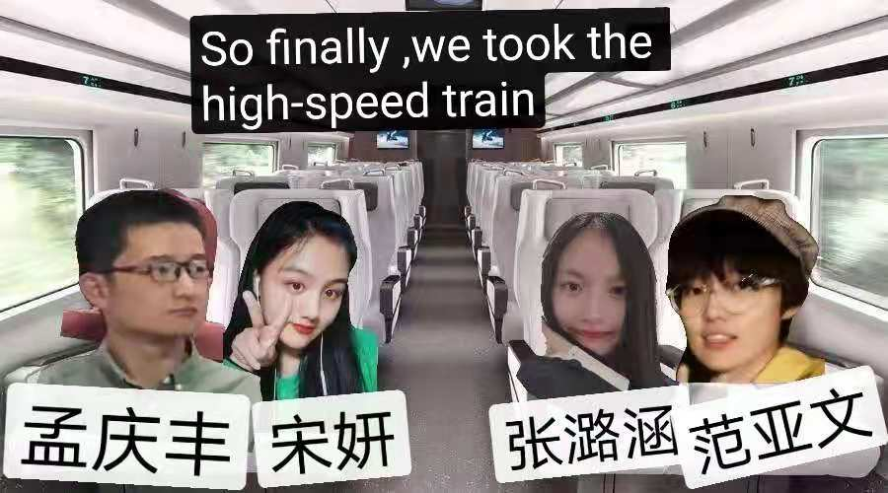
Group 2

Slide 2
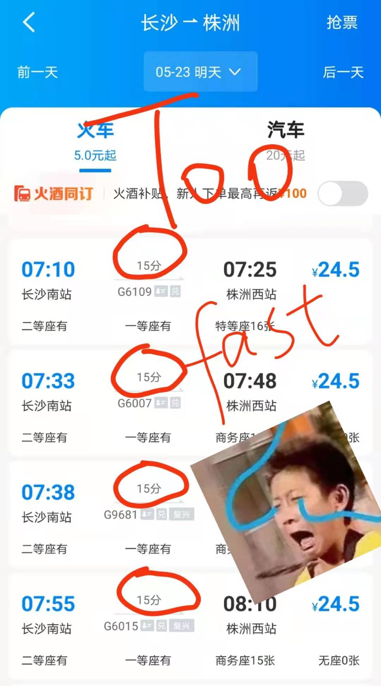

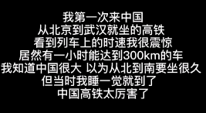
My own experience & A foreigner's sharing

Slide 3
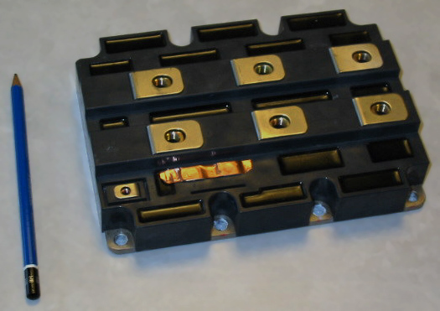
What is IGBT?
IGBT is a composite semiconductor device, which can provide strong power for the train and is the core device to realize energy conversion and transmission.

Slide 4
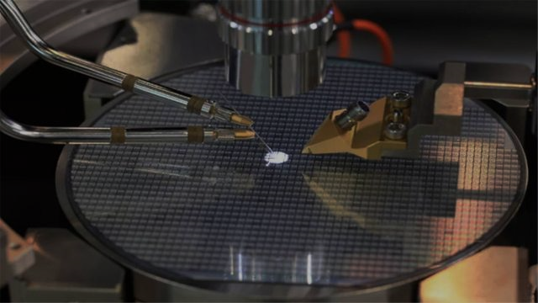
A brief history of IGBT
IGBT technology has been around for more than 30 years and has been dominated by manufacturing powers such as Germany and Japan. In 2014, China's independent research and development IGBT made a breakthrough. CRRC's IGBT has been ready for mass production in 2017. In China, we have two eight-inch IGBT production lines, each capable of producing 120,000 chips per year.
One thing I noticed in the video was that IGBT was being produced in Zhuzhou. Then I went to look up some information. CRRC Zhuzhou has rich experience in IGBT production. The core system of Fuxing is composed of more than 1000 IGBT chips, and this system is provided by CRRC Zhuzhou.

Slide 5

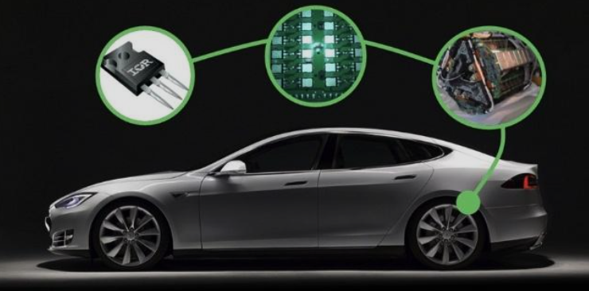
Is IGBT only used in CRRC industry?
No. IGBT technology is also widely used in smart grid, aerospace, electric vehicles, new energy equipment and other fields.

Slide 6
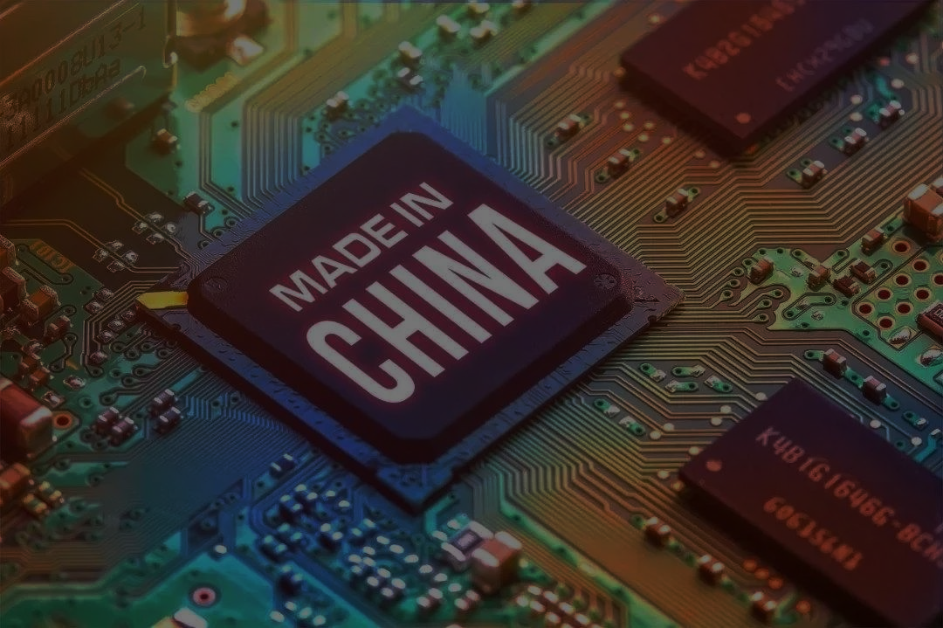
Why is there such a big breakthrough in IGBT production in China?
I am really proud of our country's achievements. I saw in the video that 80% of the equipment in the IGBT smart factory is now developed and manufactured in China.
The production of IGBT has 28 processes. In the past, manual manufacturing could only produce one per day. However, China has developed an intelligent line, which plays a role in monitoring processing data. The appearance of intelligent line not only improves the efficiency of IGBT production, but also improves the manufacturing accuracy.
I am glad to see that the workers do not have to work with their hands as before.

Slide 7
Through this study, we learnt many new words and expressions. As English majors, we are usually confined to literary knowledge, but this time we got to know some high technologies, which allows us to break the limitations of our own major and contact with new contemporary knowledge. It really broadens our horizon.

Slide 8
End

